Slide 1

CSS
Lesson 10

Slide 2
CSS Positioning
Property | Description | Values
Bottom | Sets the bottom margin edge for a positioned box | auto length % inherit
Left | Sets the left margin edge for a positioned box | auto length % inherit
position | Specifies the type of positioning for an element | absolute fixed relative static inherit
right | Sets the right margin edge for a positioned box | auto length % inherit
top | Sets the top margin edge for a positioned box | auto length % inherit
z-index | Sets the stack order of an element | number auto inherit

Slide 3
CSS Positioning
Static Positioning
HTML elements are positioned static by default. A static positioned element is always positioned according to the normal flow of the page.
Static positioned elements are not affected by the top, bottom, left, and right properties.

Slide 4
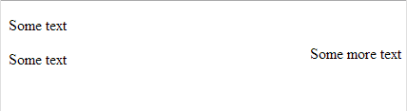
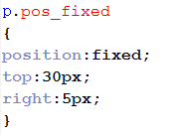

CSS Positioning
Fixed Positioning
An element with fixed position is positioned relative to the browser window.
style.css
doc.html

Slide 5
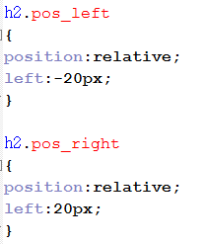
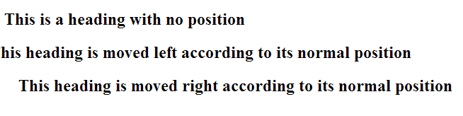
CSS Positioning
Relative Positioning
A relative positioned element is positioned relative to its normal position.
style.css
doc.html

Slide 6
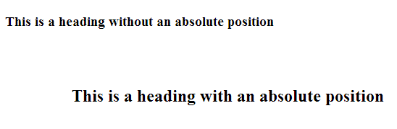
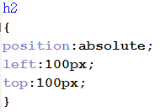

CSS Positioning
Absolute Positioning
An absolute position element is positioned relative to the first parent element that has a position other than static. If no such element is found, the containing block is <html>
style.css
doc.html

Slide 7

CSS Cursor
cursor | Specifies the type of cursor to be displayed | auto crosshair default pointer move e-resize ne-resize nw-resize n-resize se-resize sw-resize s-resize w-resize text wait help
style.css
doc.html

Slide 8
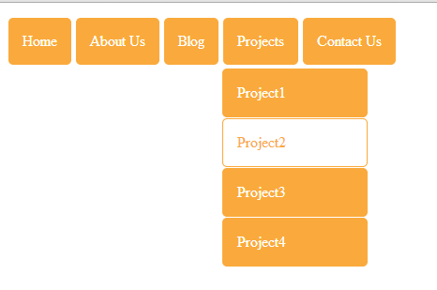
CSS Dropdown Menu

Slide 9
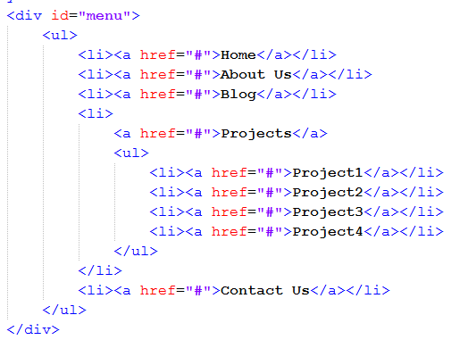
CSS Dropdown Menu
doc.html

Slide 10
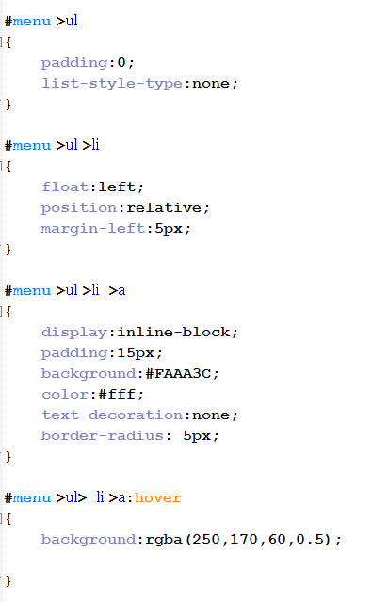
CSS Dropdown Menu
style.css
Step 1:

Slide 11
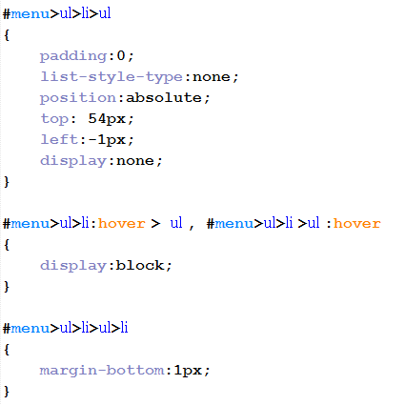
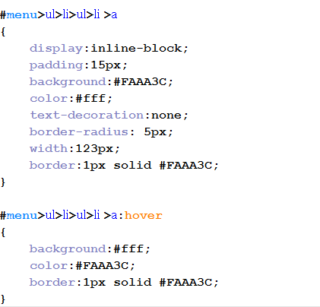
CSS Dropdown Menu
style.css
Step 2:

Slide 12

Task 1:

